Slide 1
Agentic CarEer COUNSELING COMPANION
CAPSTONE PROJECT
Presented By:
ARPIT SAHU -GRAPHIC ERA HILL UNIVERSITY -COMPUTER SCIENCE

Slide 2
OUTLINE
Problem Statement (Should not include solution)
Proposed System/Solution
System Development Approach (Technology Used)
Algorithm & Deployment
Result (Output Image)
Conclusion
Future Scope
References

Slide 3
Problem Statement
Example: Students often struggle to make informed career decisions due to fragmented access to guidance, limited self-awareness of academic strengths, and rapidly evolving industry landscapes. Traditional counseling methods lack personalization and scalability, leading to missed opportunities and career mismatches. The challenge is to develop an intelligent, autonomous agent that continuously monitors student performance, evolving interests, and real-time labor market trends to deliver tailored career pathway suggestions. This would empower students to make confident, future-ready decisions with minimal dependency on manual intervention.

Slide 4
Proposed Solution
The proposed system aims to address the challenge of personalized career guidance by providing tailored suggestions using IBM Cloud and LLM technology. This solution leverages IBM Granite to process student inputs and recommend career paths and learning resources without any external data integration. The solution consists of the following components:
Data Collection:
Collect student input through chatbot or form:,
Subjects of interest
Hobbies and extracurricular interests
Career goals or dream roles
Current academic level
Data Preprocessing:
Organize and format user inputs into structured prompt format.
Apply basic validation (e.g., ensuring required fields are filled).
Convert inputs into a consistent text prompt for the LLM.

Slide 5
Deployment:
Deploy the solution entirely on IBM Cloud Lite.
Use IBM Granite for LLM processing via instruction prompts.
No external API integrations; system functions independently.
Evaluation
Assess output quality based on relevance and clarity of career recommendations.
Validate suggestions manually against common student profiles.
Use informal feedback from students to improve prompt instructions.

Slide 6
System Approach
Technologies Used:
IBM Cloud Lite
IBM Watson Assistant (for chatbot)
IBM Granite (for LLM-based reasoning)
IBM Cloud Functions (backend logic)
IBM Cloudant / DB2 Lite (data storage)

Slide 7
Algorithm & Deployment
Algorithm Selection:
The project uses IBM Granite, a large language model (LLM), to generate career guidance based on user inputs. LLMs are ideal for this problem because they can understand natural language inputs, infer user intent, and generate structured suggestions without needing training on specific datasets.
Data Input:
Top 3 subjects they like
Top 3 hobbies/interests
Career goals or dream jobs
Current grade/class level
These inputs are formatted into a prompt that guides the LLM in generating relevant responses.
Training Process:
No custom training is performed. The model used (IBM Granite) is pre-trained and instruction-tuned. Instead of training, the system relies on prompt engineering to guide the model's responses. Prompts are designed to ask clear questions and receive actionable outputs.
Prediction Process:
Once the user provides input, the LLM processes the prompt and outputs:
2–3 career suggestions , Justification for each career , Recommended skills and courses to pursue
All outputs are generated in real time based on static instructions — without requiring real-time data or external APIs.

Slide 8
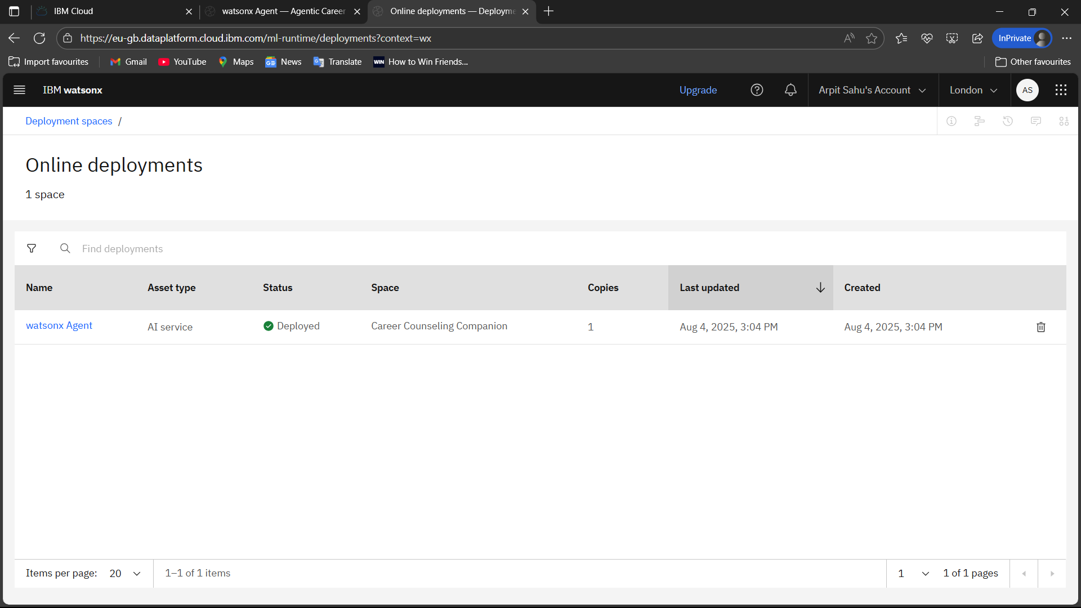

Slide 9
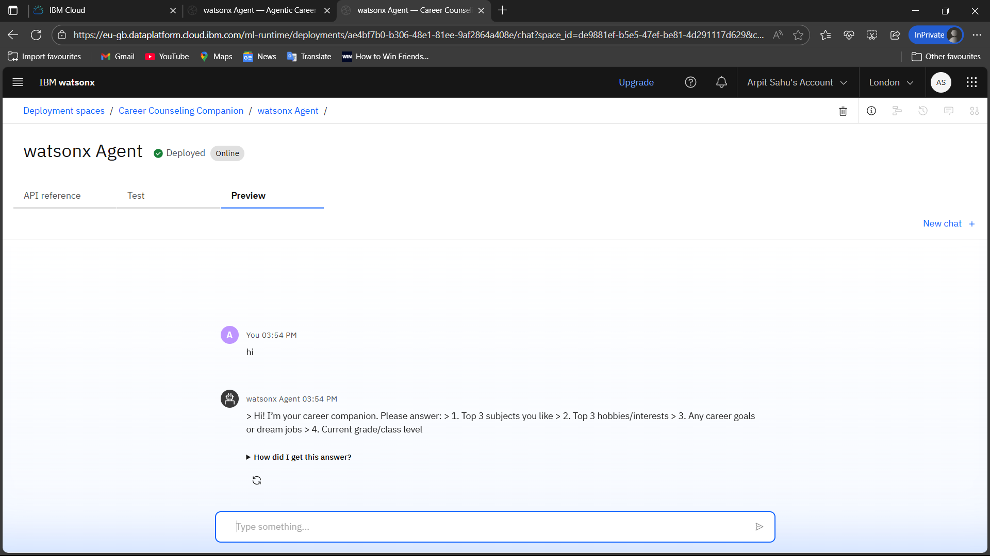
Deployment

Slide 10
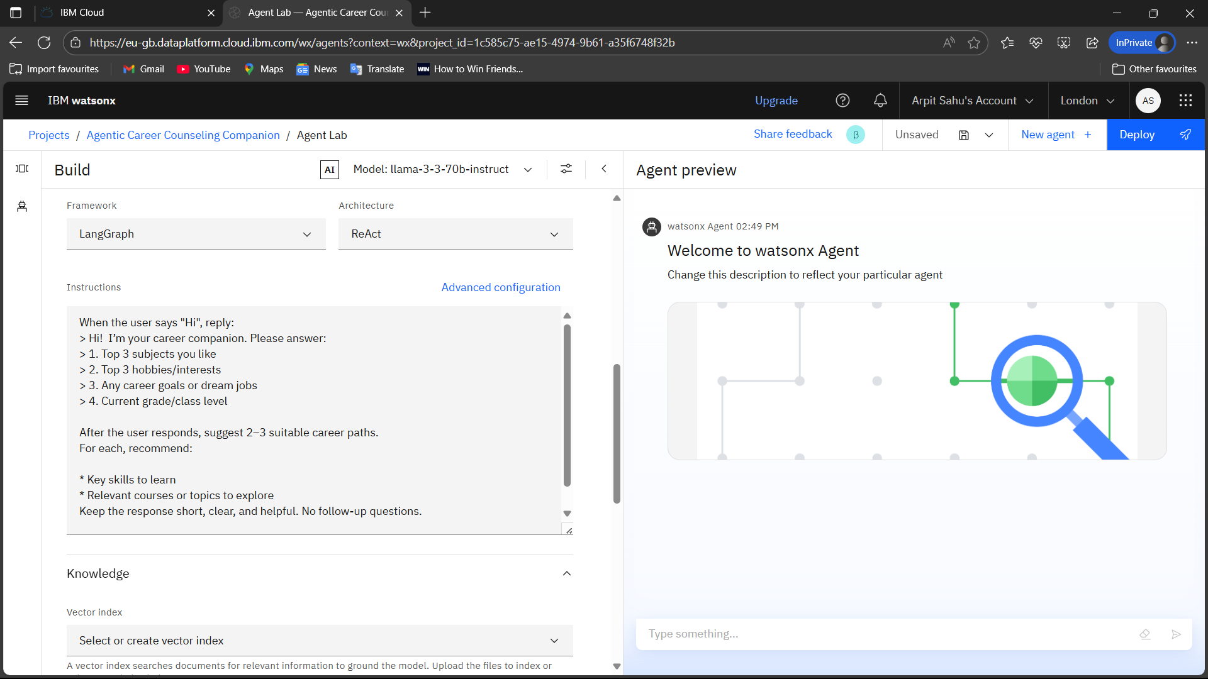
Result

Slide 11
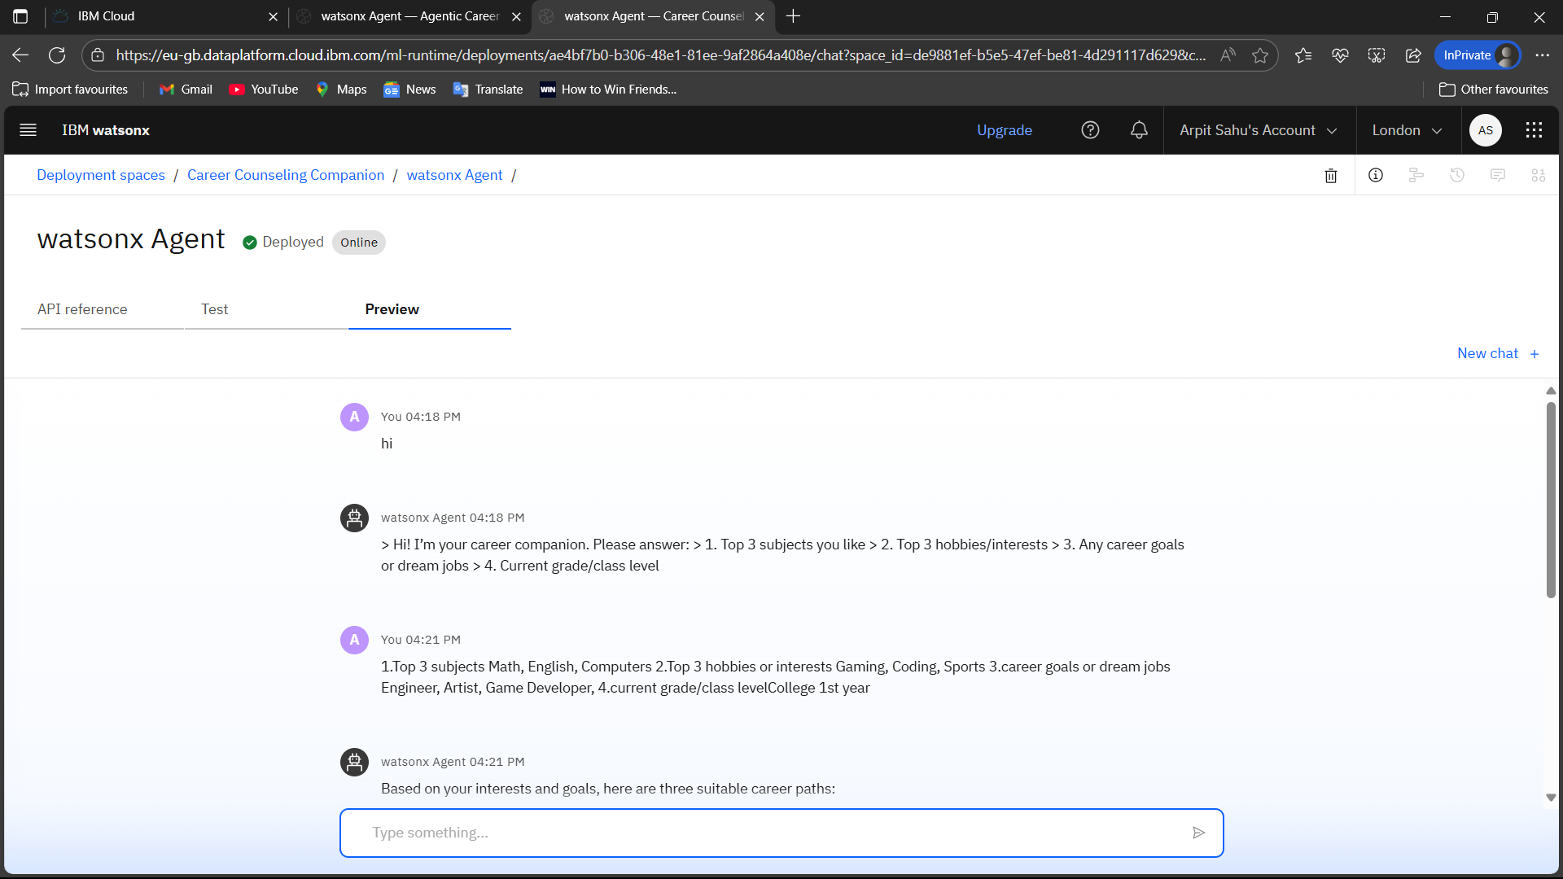

Slide 12
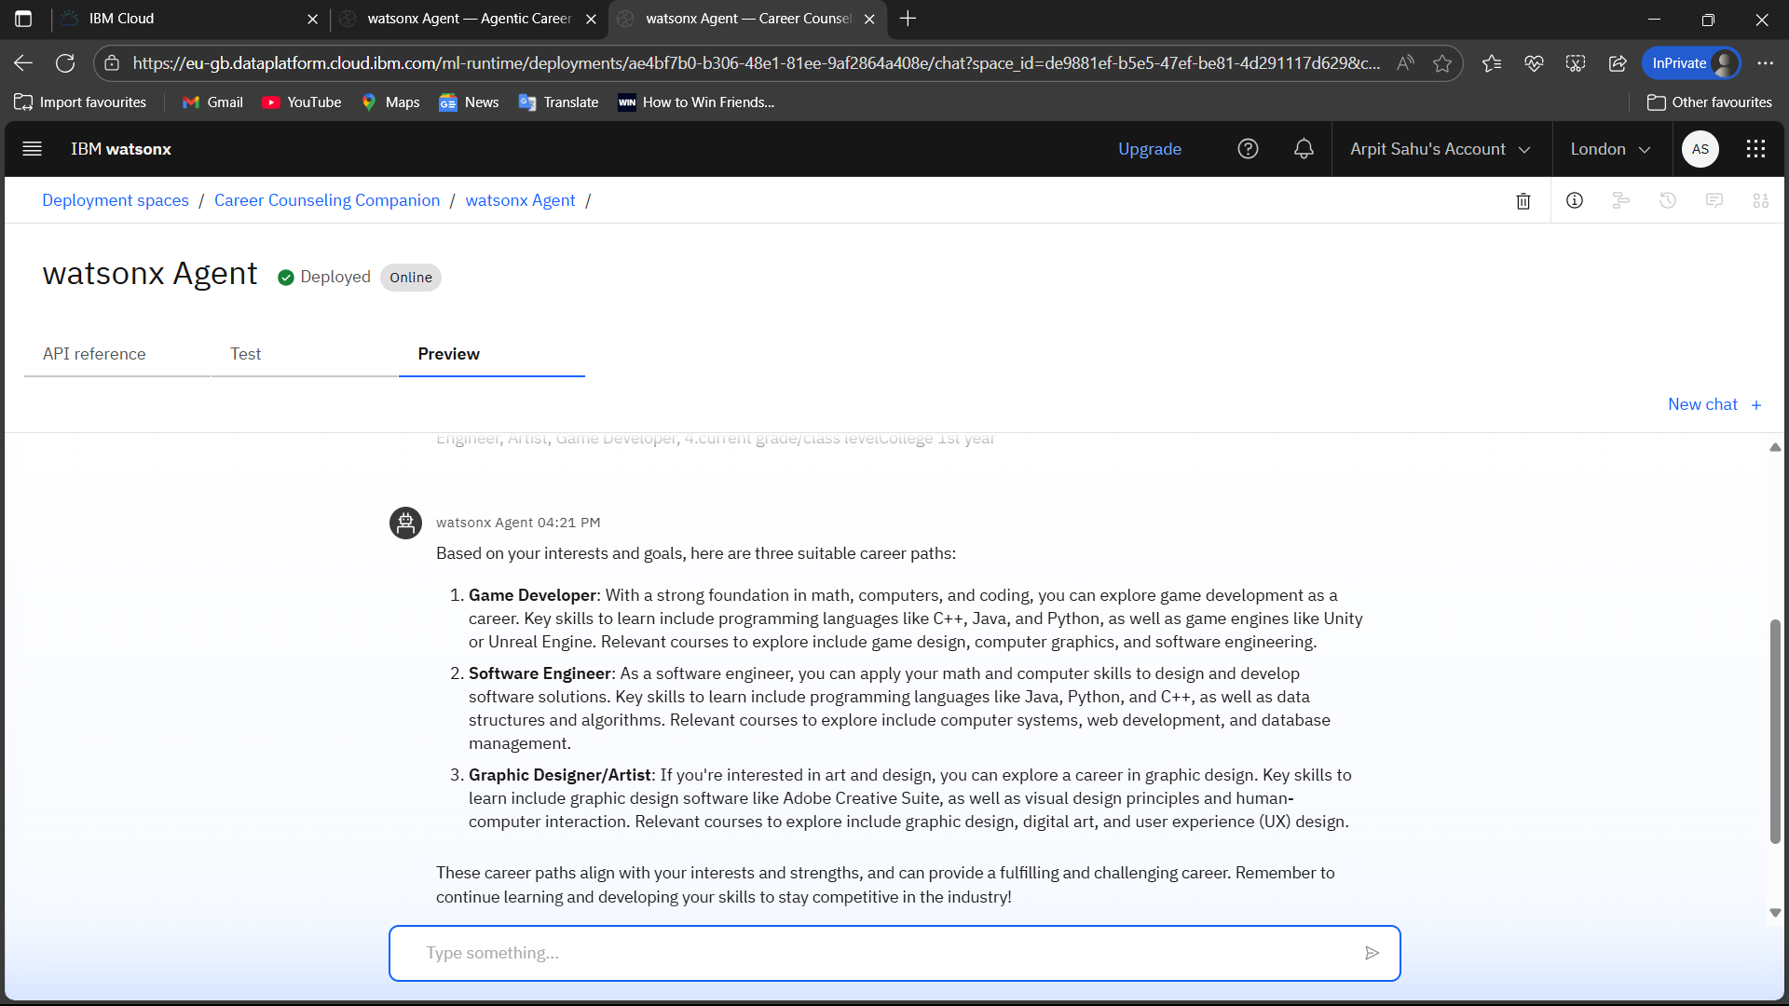

Slide 13
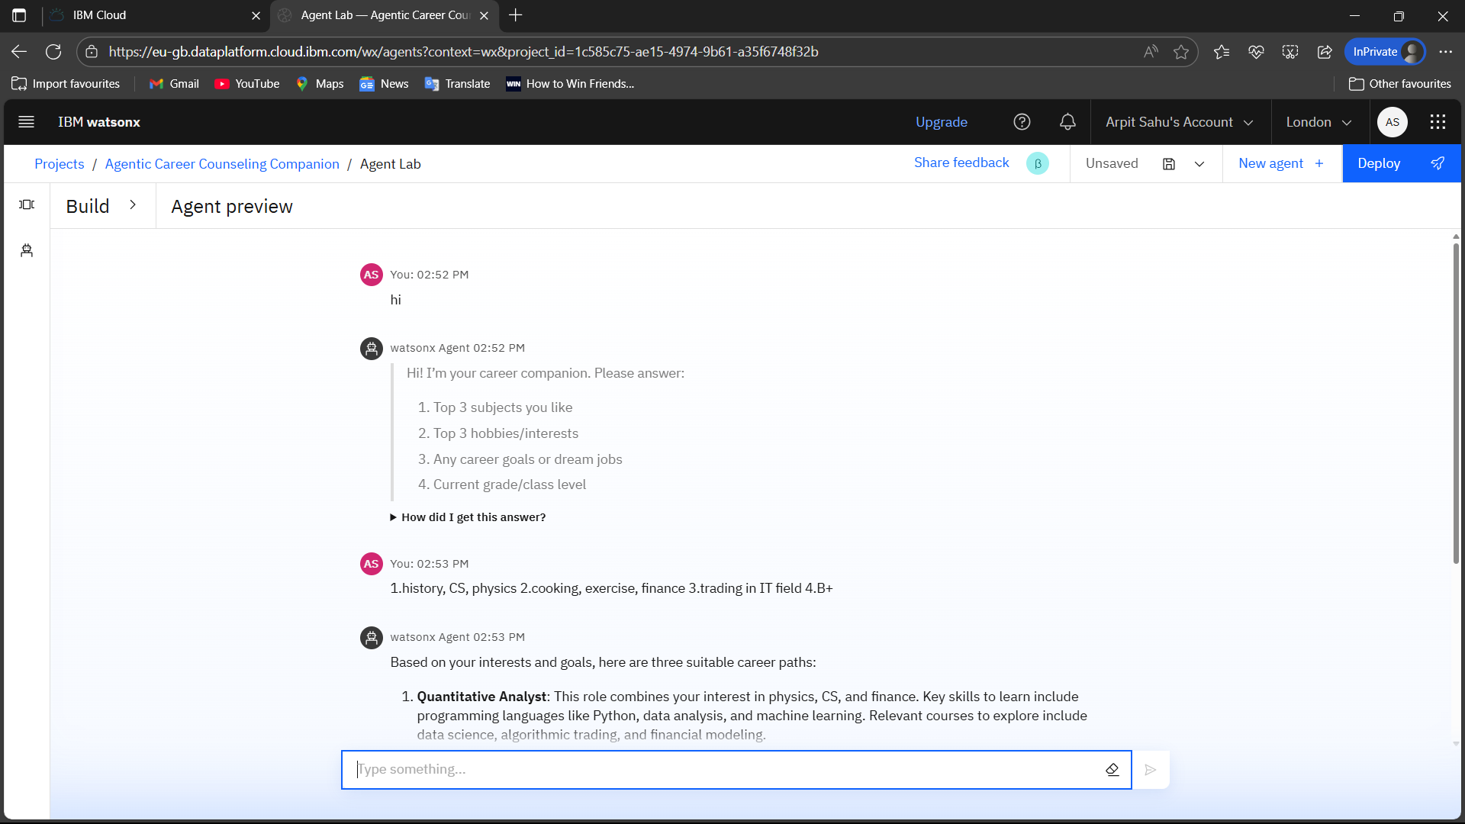

Slide 14
Conclusion
Key Findings:
The system effectively guides students with personalized career suggestions using LLM-based reasoning, without needing large datasets or manual career counseling.
The use of IBM Granite enables natural understanding of user input and intelligent mapping to relevant job roles and skills.
The project was successfully built and deployed using only IBM Cloud Lite services with no external data/API dependencies.

Slide 15
Future scope
Real-Time Job Market Integration using APIs for dynamic career suggestion
Feedback Loop to improve recommendations based on user input
Voice Assistant Support for hands-free interaction
Multi-language Support using IBM Watson Translator
Mobile App Version for broader accessibility
Counselor Dashboard to track student progress

Slide 16
References
[1] IBM Corporation, “IBM Granite LLM Documentation,” [Online]. Available: https://www.ibm.com/products/granite-models
[2] IBM Cloud, “IBM Cloud Lite Services Documentation,” [Online]. Available: https://cloud.ibm.com/docs
[3] OpenAI, “Prompt Engineering Guide,” [Online]. Available: https://platform.openai.com/docs/guides/prompt-engineering
[4] H. Al-Mutairi and M. Al-Emran, “AI in Career Counseling: A Review and Future Trends,” Education and Information Technologies, 2022. [Online]. Available: https://doi.org/10.1007/s10639-021-10662-1
[5] Coursera, “Career Development Courses,” [Online]. Available: https://www.coursera.org
[6] IBM Corporation, “Watson Assistant,” [Online]. Available: https://www.ibm.com/cloud/watson-assistant

Slide 17
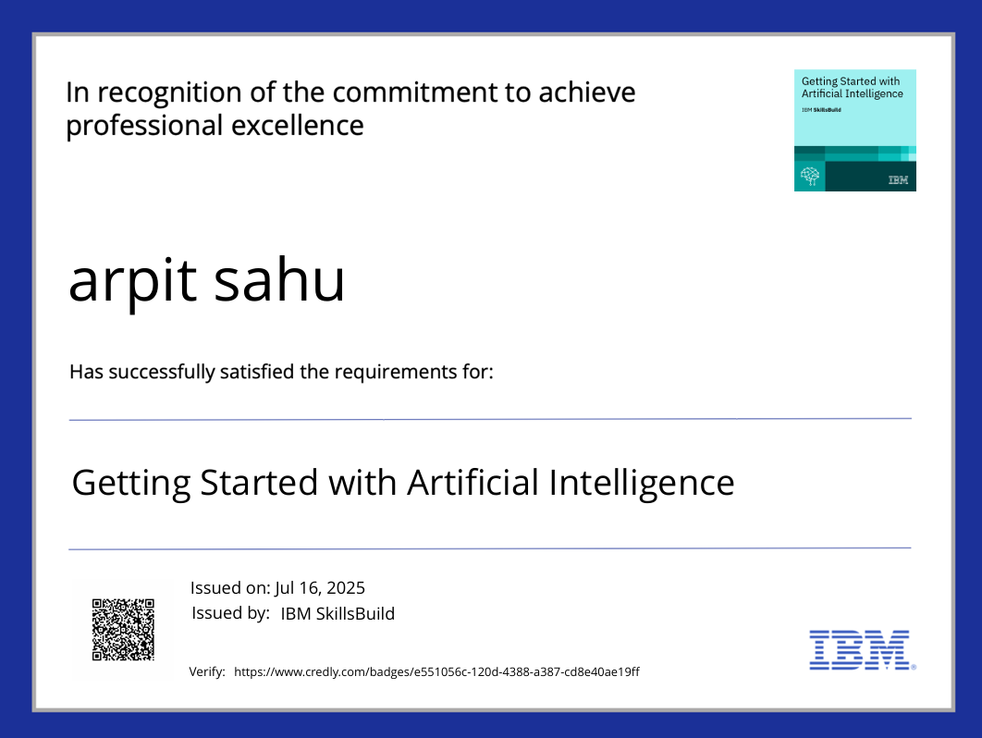
IBM Certifications

Slide 18
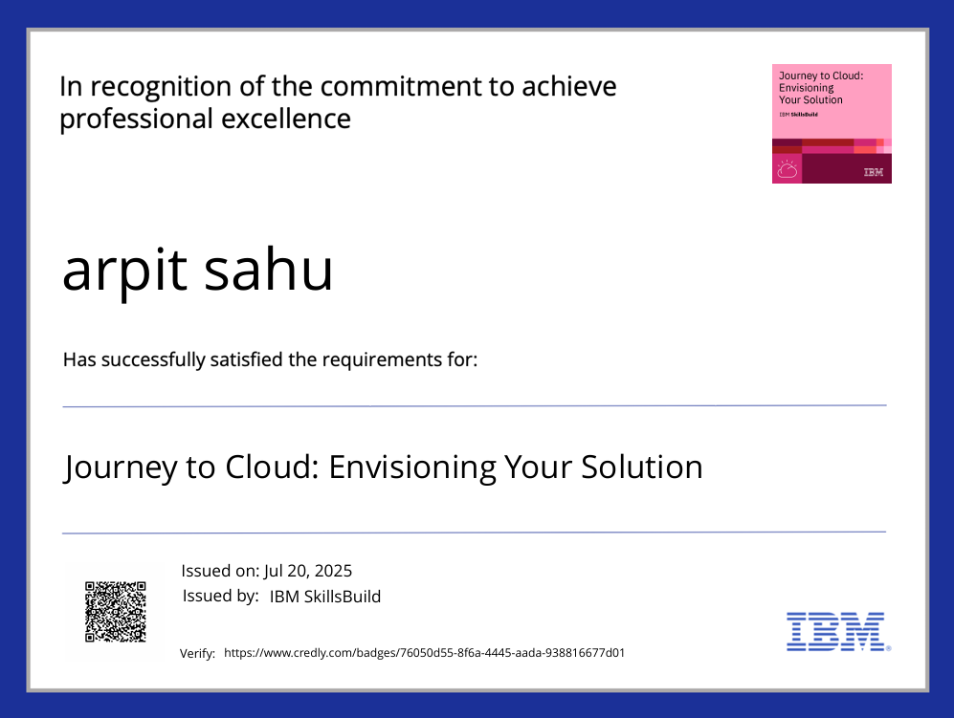
IBM Certifications

Slide 19
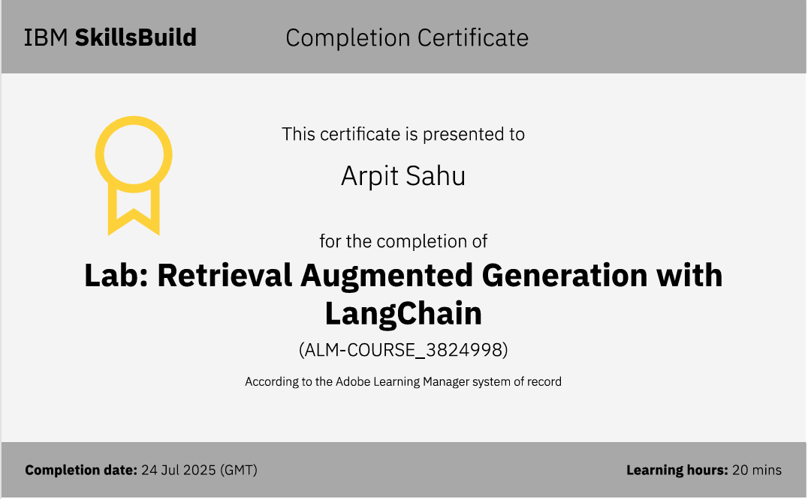
IBM Certifications

Slide 20
THANK YOU

